Slide 1
Group 9: Air Quality and Pollution Analysis using Big Data Tools
Computer Science and Engineering Department
Team Members
R. Saikumarreddy (11690966)
Mohammed Sifatullah (11754580)
Krishna Chaitanya Kandepu (11785315)
Karanam Dimpu Nithish (11823599)

Slide 2
Outline
1.Project Overview 2.Objectives 3.Workflow 4.Architecture 5.Data Set 6.Analysis of data 7.Conclusion 8.Project Management 9.Responsibility & Contributions 10.Challenges & References

Slide 3
Project Overview
Project 1: Phase 1 - Preprocessing data using Hive
We started with downloading the available dataset at the UCI Machine Learning Repository containing hourly concentration of severaldifferent kinds of pollutants for an extended period of time. The dataset contains CO, NO₂, C₆H₆ (Benzene), temperature, humidity, and sensor measures. With Apache Hive on AWS, we: Imported raw data into a Hive table Undertook preprocessing procedures including: Null or invalid values elimination Basic clean-up and formatting Developed a clean, well-structured CSV file ready for machine learning Phase 2: ML Model Training & Visualization with SageMaker
After cleaning, the data set was loaded into an S3 bucket (finalprojectbigdata2) and into the ML workflow within AWS SageMaker Studio. Throughout this period: A Linear Regression model was built with Scikit-learn within Jupyter Notebook (.ipynb) for use with SageMaker Several of these characteristics (nox_gt, no2_gt, c6h6_gt, t, rh) were used to predict CO concentration (co_gt) The model possessed an R² of around 0.97, which reflects its good prediction potential Visualizations created: Actual vs Predicted CO Scatter Plot Residual Histogram Feature Coefficients Bar Chart All of these generated charts were automatically saved back to S3 under charts/.

Slide 4
Objectives
Primary Goal:-
Building a machine learning pipeline based on the cloud to predict carbon monoxide (CO) pollution levels based upon environmental sensor data, utilizing AWS components (SageMaker, S3, Hive) and training a Linear Regression model.
Secondary Goals:-
Preprocessing and cleaning air quality data with Apache Hive on AWS
For accessing and storing data from Amazon S3 for secure, scalable integration into the cloud
Create, Train, and Test a Regression Model Using Scikit-learn in SageMaker Studio
To examine trends and patterns of pollution concentration through data visualizations
In order to save output automatically by writing charts to S3 for reporting and analysis
Key Features of the Project:-
A cloud-native ML pipeline leveraging Hive for data preprocessing and training via SageMaker is being used for the project. All of the data and results were properly managed with scalable storage and automation through Amazon S3 A Linear Regression model was used to predict CO based upon environmental attributes like NO₂, Benzene, RH, and Temp. It was remarkably accurate and created visual results that were returned automatically to S3.

Slide 5
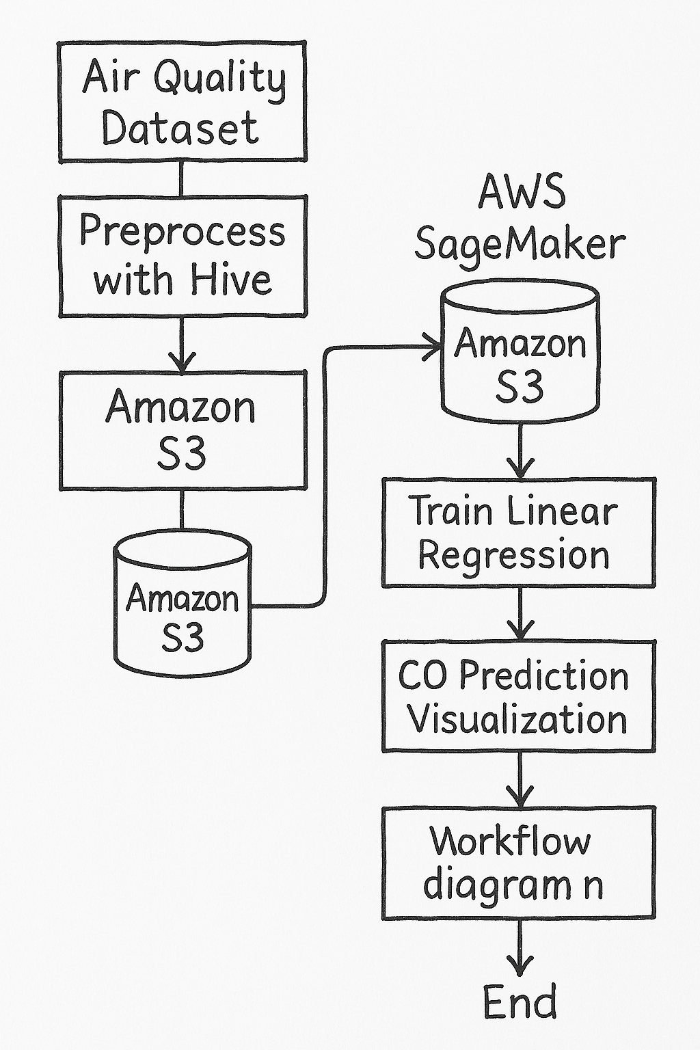
Workflow
Data Preprocessing with Hive
Raw air quality data can be obtained through the UCI repository.
Link: https://archive.ics.uci.edu/dataset/360/air+quality
It is cleaned by Apache Hive to remove invalid and null values.
Processed data is stored in Amazon S3 for ready access to the cloud
Model Training with SageMaker
AWS SageMaker Studio imports data that is already preprocessed from S3.
A Linear Regression model is trained with selected features to predict CO.
All of this is done in the cloud through Scikit-learn and Jupyter notebooks.
Result Visualisation and Storage
These include visualizations of scatter plots, residuals, and coefficient plots.
These are employed to describe model performance and influence of features.
All visualizations are automatically stored to the S3 bucket (charts/.

Slide 6
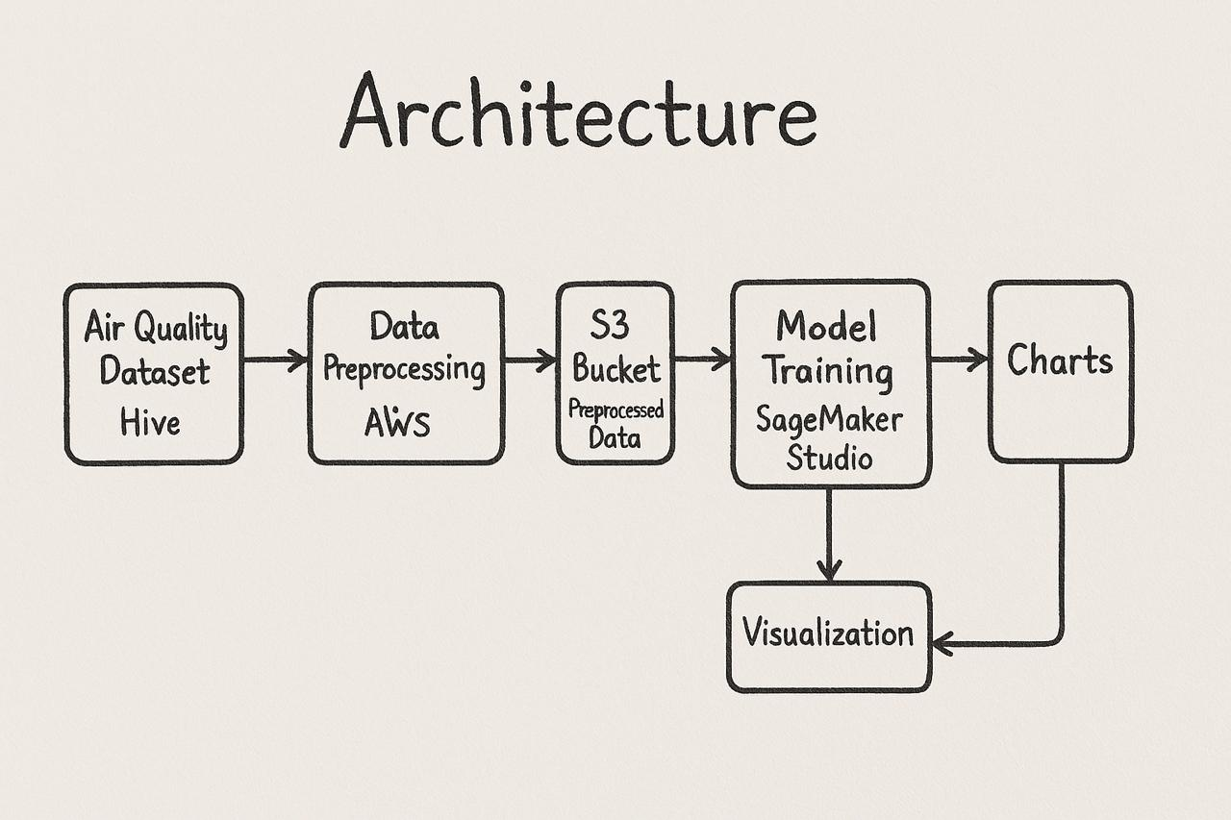
Architecture:
Air Quality Dataset → Hive Preprocessing Raw data is ingested and cleaned by Apache Hive within AWS formissing values treatment and structuring.
Processed Data → Amazon S3 The data is loaded into an S3 bucket, which stores it securely and atscale for subsequent machine learning computation.
S3 → Training for AWS SageMaker A Linear Regression model is trained with preprocessed data, includingfeatures of NO₂, C₆H₆, temperature, and humidity, via SageMaker Studio.
Model Output → Visualization → S3 Charts These are forecasted and plotted by the model and, independently, written back to the S3 bucket as graphs in a folder called charts/.

Slide 7
Data Set Over view
Source: UCI Air Quality Dataset
Attributes: Date, Time, CO, NO2, Benzene, Temperature, Humidity, Sensor responses, etc.
Size: Large-scale hourly pollution data collected from monitoring stations.
Link: https://archive.ics.uci.edu/dataset/360/air+quality
Key Features: The data set has raw sensor data of different pollutants, we are filtering the data by removing the null values and Normalizing pollutant concentrations for data analysis.

Slide 8
Project-1 : Analysis of Data:
Data Pre-processing Steps: Using Hive 1.Replace Missing Values (-200) with NULL(our data set has null values mentioned as -200)
2.Verify Missing Value Handling 3.Removing Rows with All NULL Values in the table 4.Verifying the Filtered Data 5.Normalizing the Data 6.Verify Normalized Data 7.Aggregating Data by Date 8.Verifying Aggregated Data 9.Finding Days with High CO Levels 10.Verifying High Ozone Levels 11.Verifying High Pollution Days 12.Verifying Temperature Values 13.Saving Processed Data to S3

Slide 9
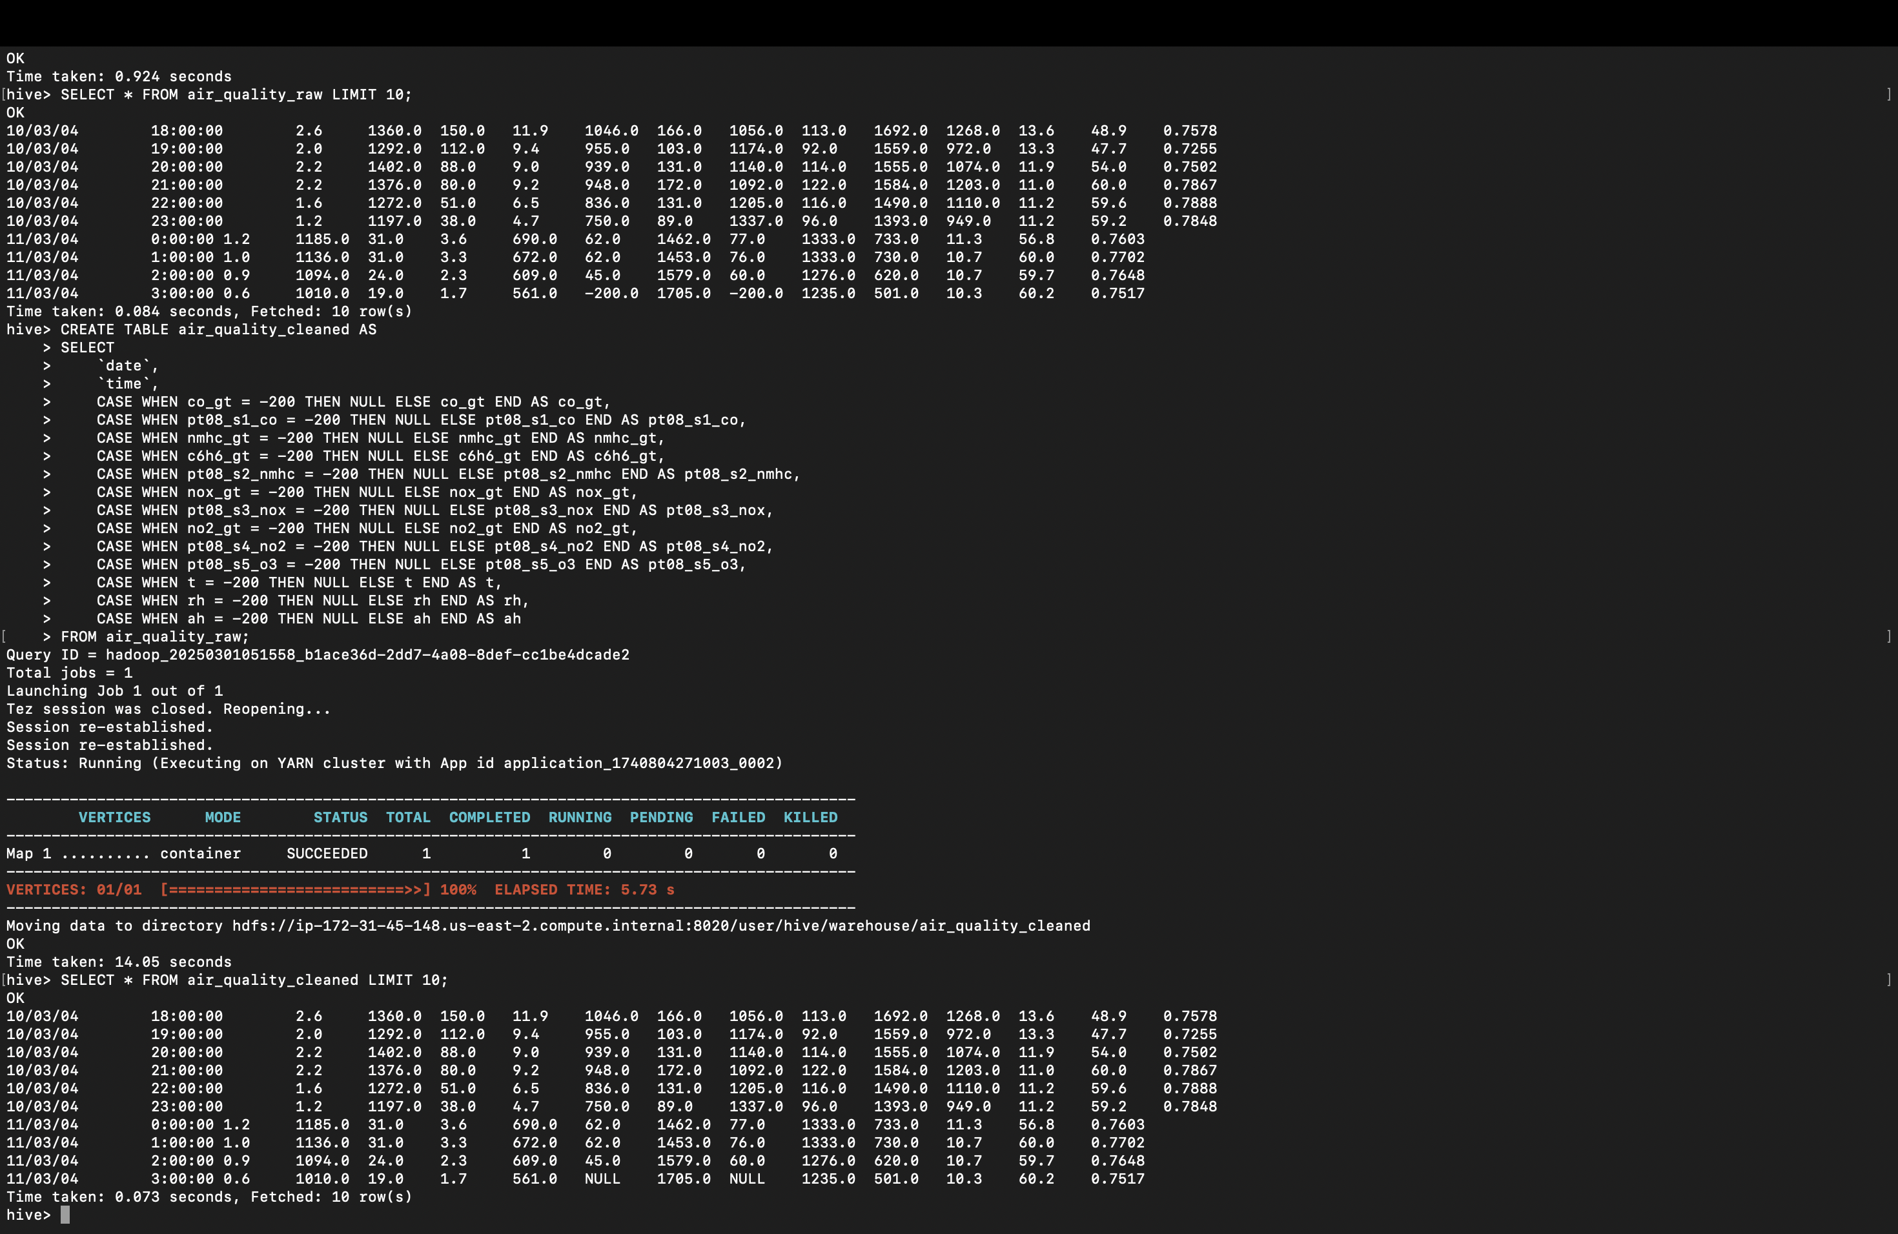
Step 01:
1.Replacing Missing Values (-200) with NULL(our data set has null values mentioned as -200)
2.Verifying the Missing Value Handling After replacing -200 with NULL in the air_quality_cleaned table, verifying the result .
3.Remove Rows with All NULL Values and Verify the Filtered Data

Slide 10
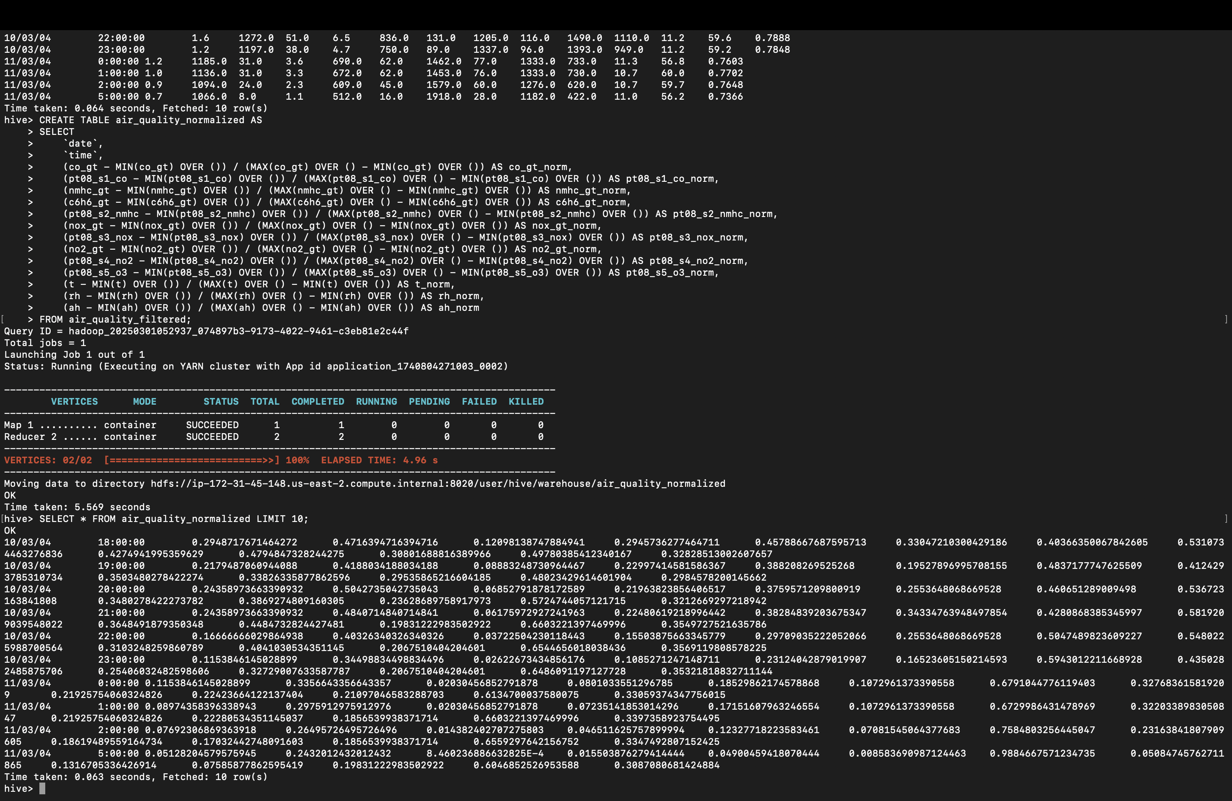
Step02:Normalize the Data and Aggregate Data by Date
Now, normalize the data in the air_quality_filtered table. Since all NULL values have been removed, the normalization will work at most Accuracy and we are doing Min-Max Normalisation to the numerical columns scaling between 0 and 1 to compare different attributes with different ranges Verifying the Normalized Data :
The query aggregates air quality data by date by calculating the daily average values of the pollutants, temperature and humidity it uses the Group By to group the data and applies avg() to each numerical value. This helps in summarizing hourly data into daily trends to get the Better insights

Slide 11
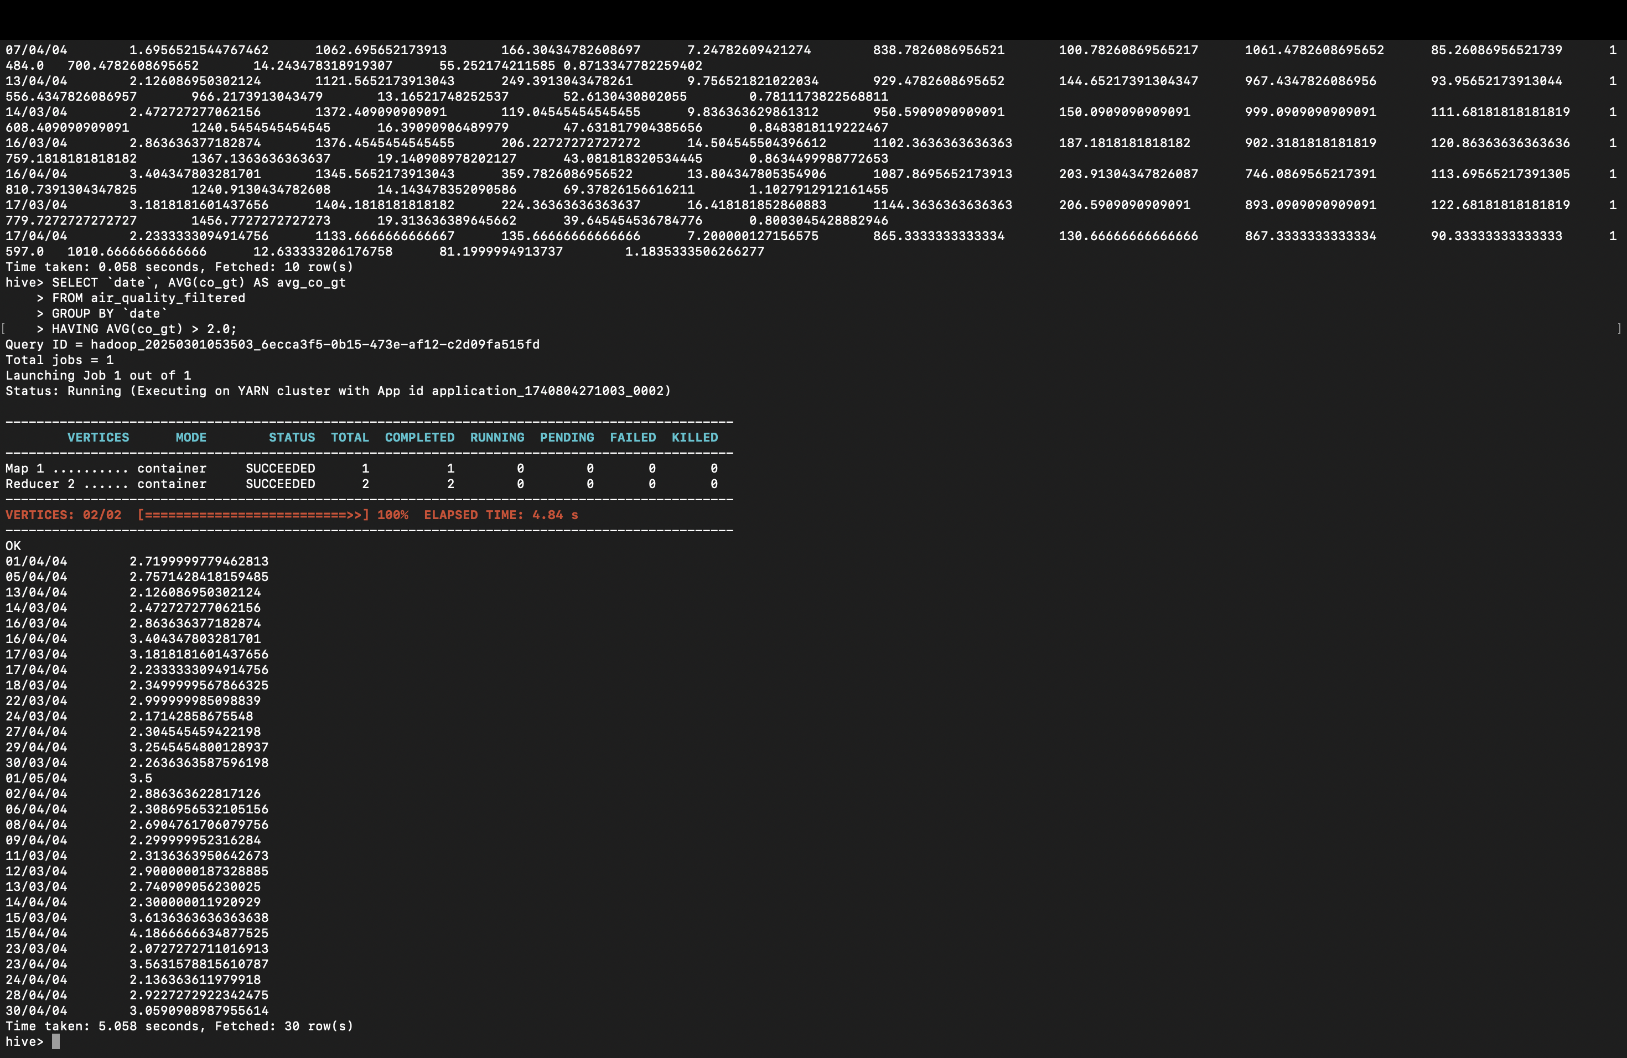
Step03:Finding Days with High CO Levels and Saving Processed Data to S3
Finding the carbon monoxide levels having threshold greater than 2
Verifying High Ozone Levels
finding the average ozone levels measured by avg_pt08_s5_o3 greater than 1000.
Here we are storing the processed data to the S3 bucket

Slide 12
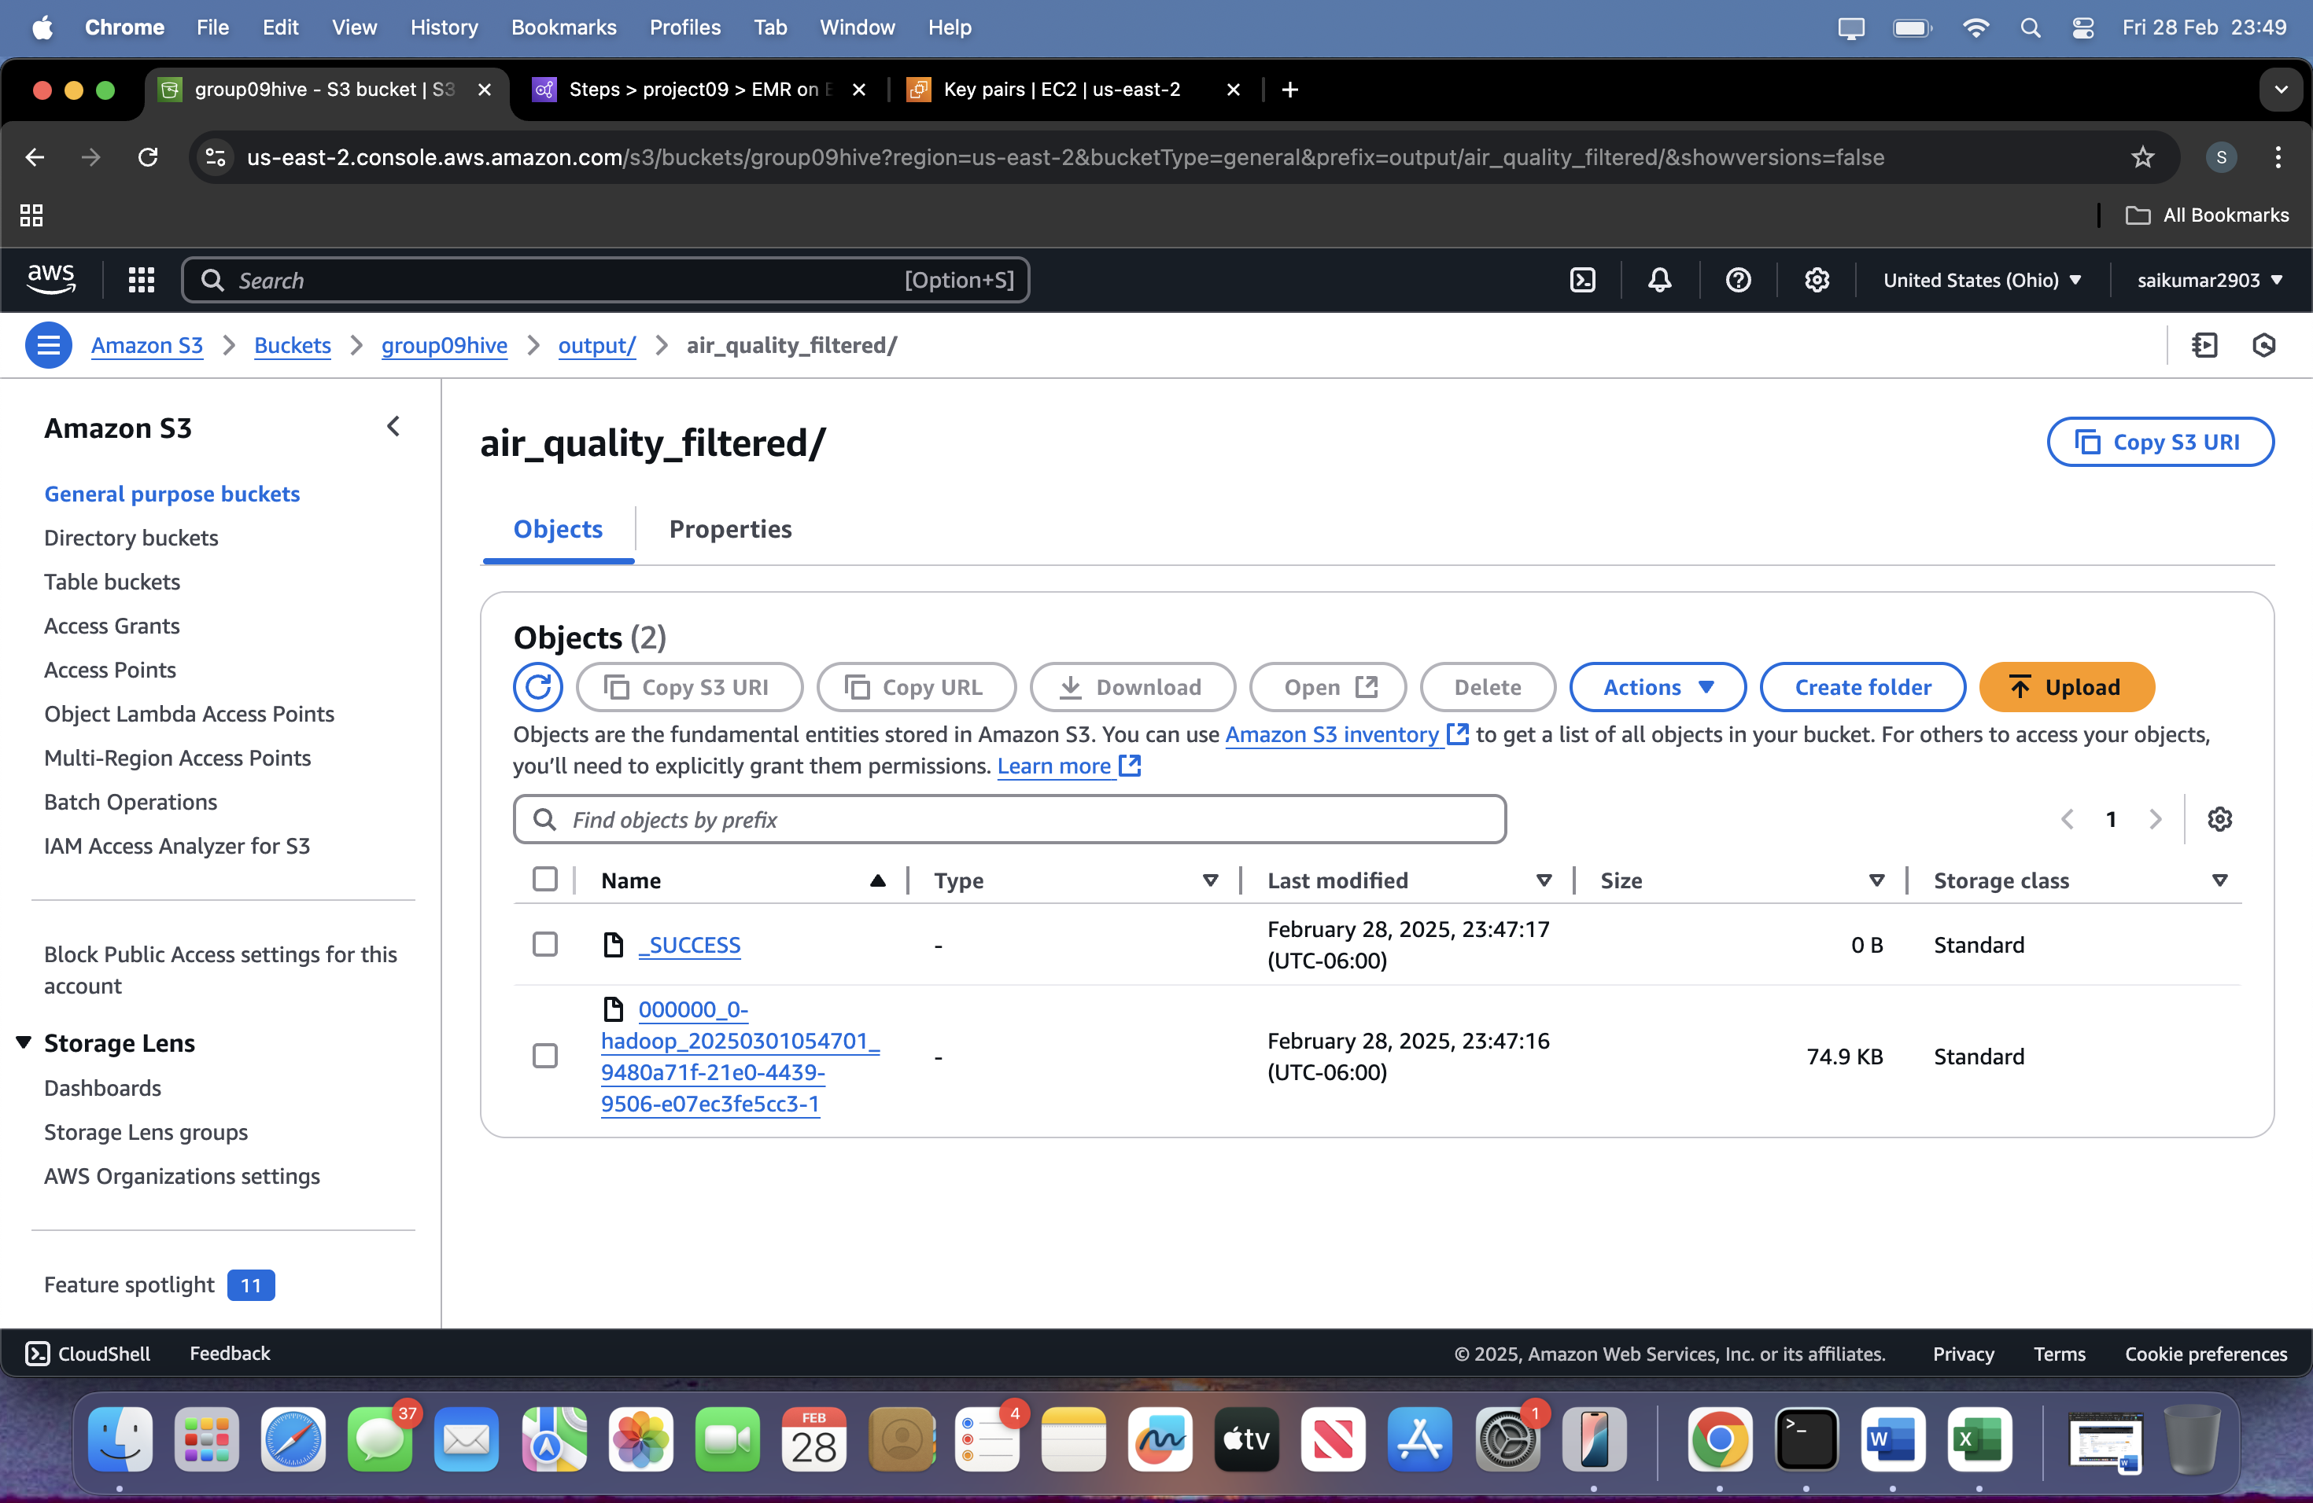
Output:
The air quality dataset was cleaned and filtered using Apache Hive on AWS.
The output was saved in the S3 bucket under the path: group09hive/output/air_quality_filtered/
The presence of the _SUCCESS file confirms successful execution.
The .csv-like output file contains the preprocessed dataset, ready for ML training in SageMaker.

Slide 13
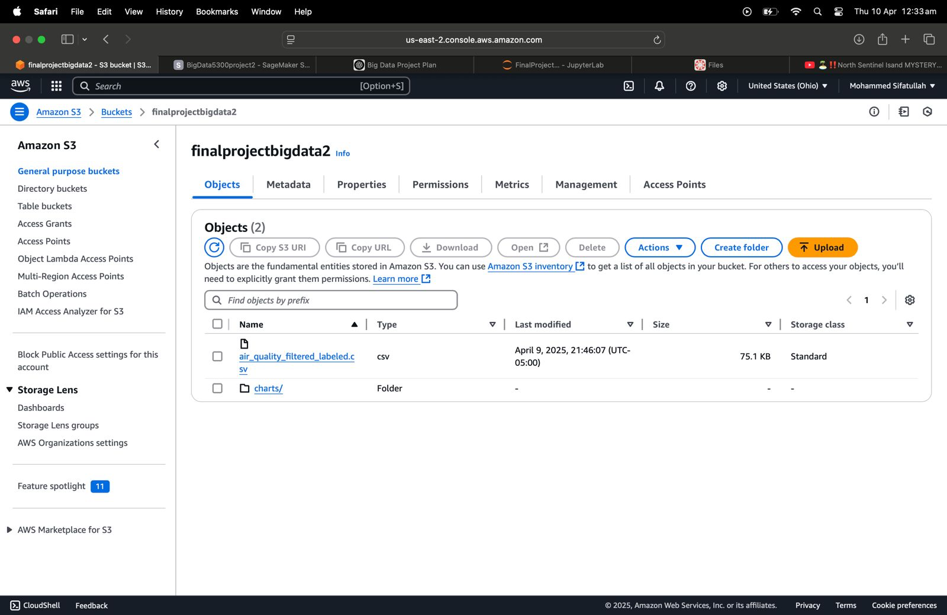
Project-2: ML Model Training & Visualization with SageMaker
S3 Bucket Setup for ML Model:-
Created a new S3 bucket named finalprojectbigdata2 for storing the preprocessed data.
Uploaded filtered and labeled CSV file: air_quality_filtered_labeled.csv, to be utilized during training of the ML model.
The bucket is utilized as a data source for SageMaker Studio, an end-to-end machine learning workflow in the cloud.

Slide 14
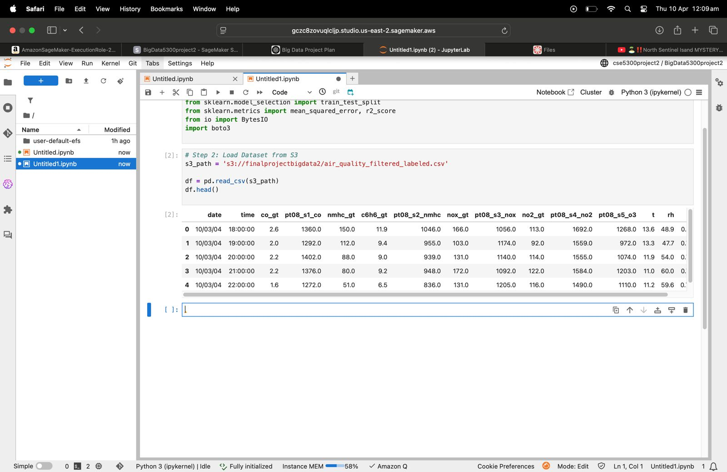
Loading the Preprocessed Dataset from S3:
The preprocessed air quality dataset was stored in in Amazon S3 as air_quality_filtered_labeled.csv.
In SageMaker Studio, we used Pandas to load the CSV file directly from the S3 bucket using its path.
The data contains various features like CO, NOx, NO2, Benzene (C6H6), Temperature (T), and Relative Humidity (RH), which are used for training the ML model.

Slide 15
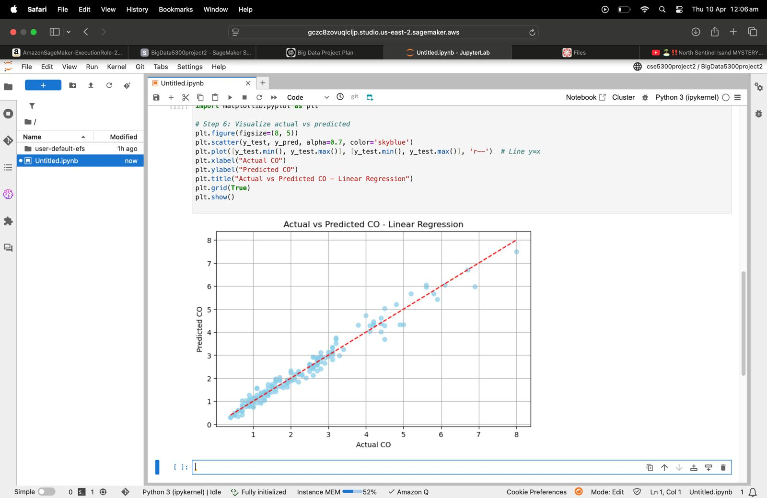
ML Model Visualization Workflow:
Actual vs Predicted CO Scatter Plot:
This plot compares the actual CO levels from the test data with the predicted values by the Linear Regression model.
The red dashed line represents a perfect prediction (y = x).
The clustering around the line indicates high model accuracy.

Slide 16
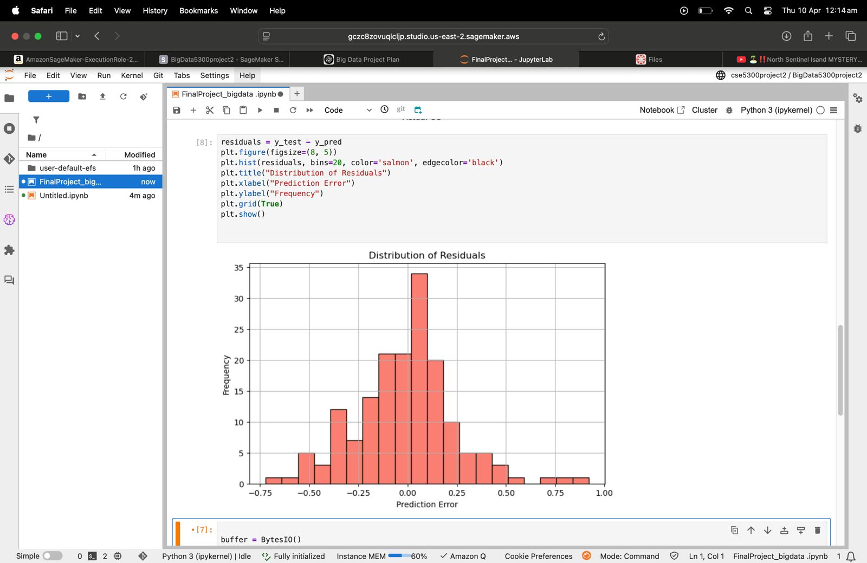
Residuals Distribution Histogram:
This histogram depicts prediction errors (residuals = actual - predicted).
There is little error and the residuals group around zero.
This confirms that the model is generalizing without
apparent bias.

Slide 17
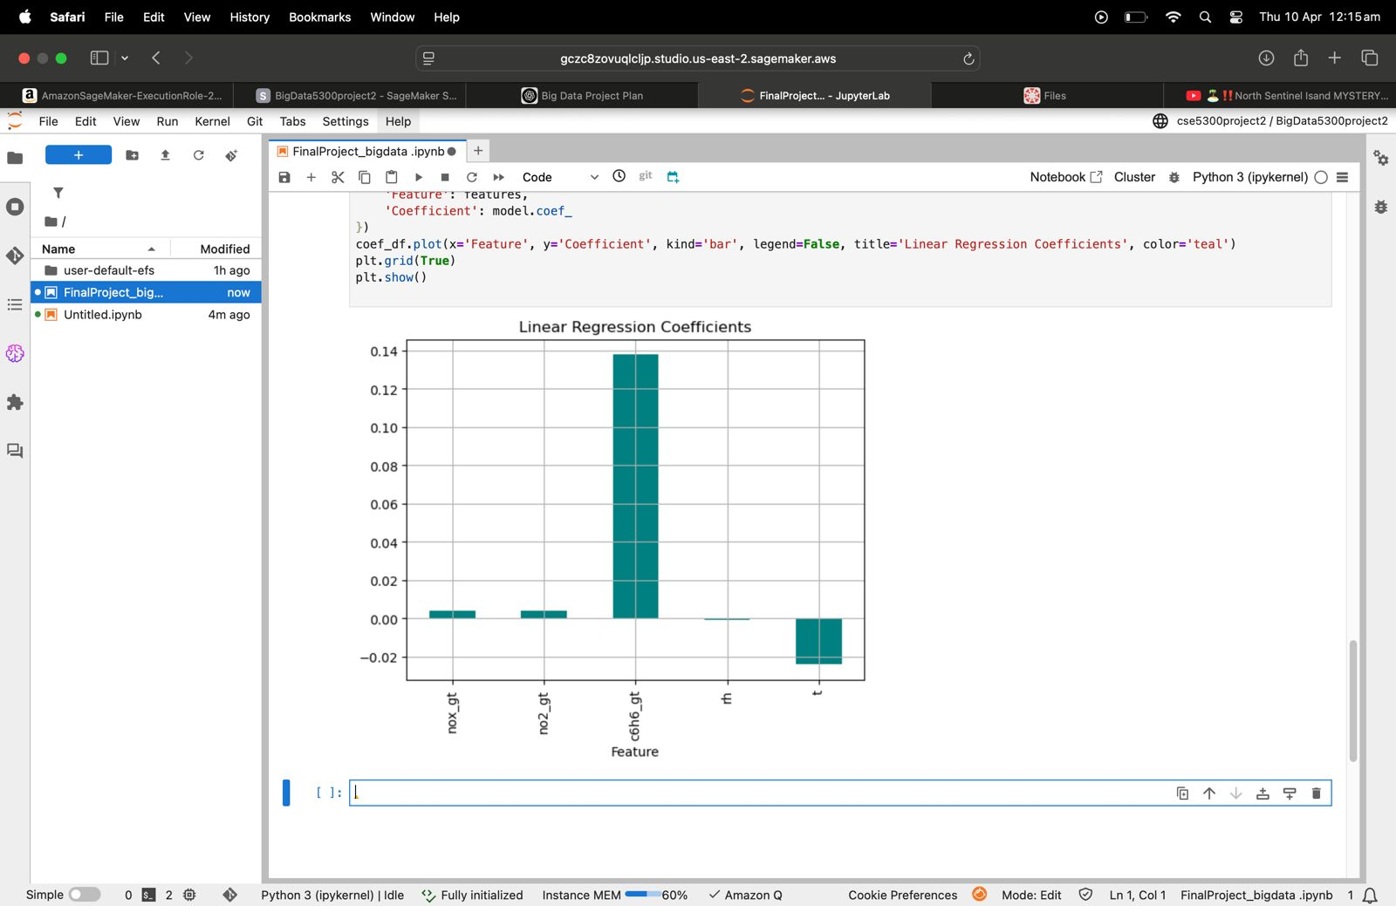
Feature Importance – Linear Regression Coefficients:
A bar plot of how each of these characteristics (NOx, NO², Benzene, RH, Temperature) contribute to predict CO.
Benzene (C₆H₆) exerts the most beneficial effect and temperature exerts a negative effect.
These help to characterize the model and control pollution behavior.

Slide 18
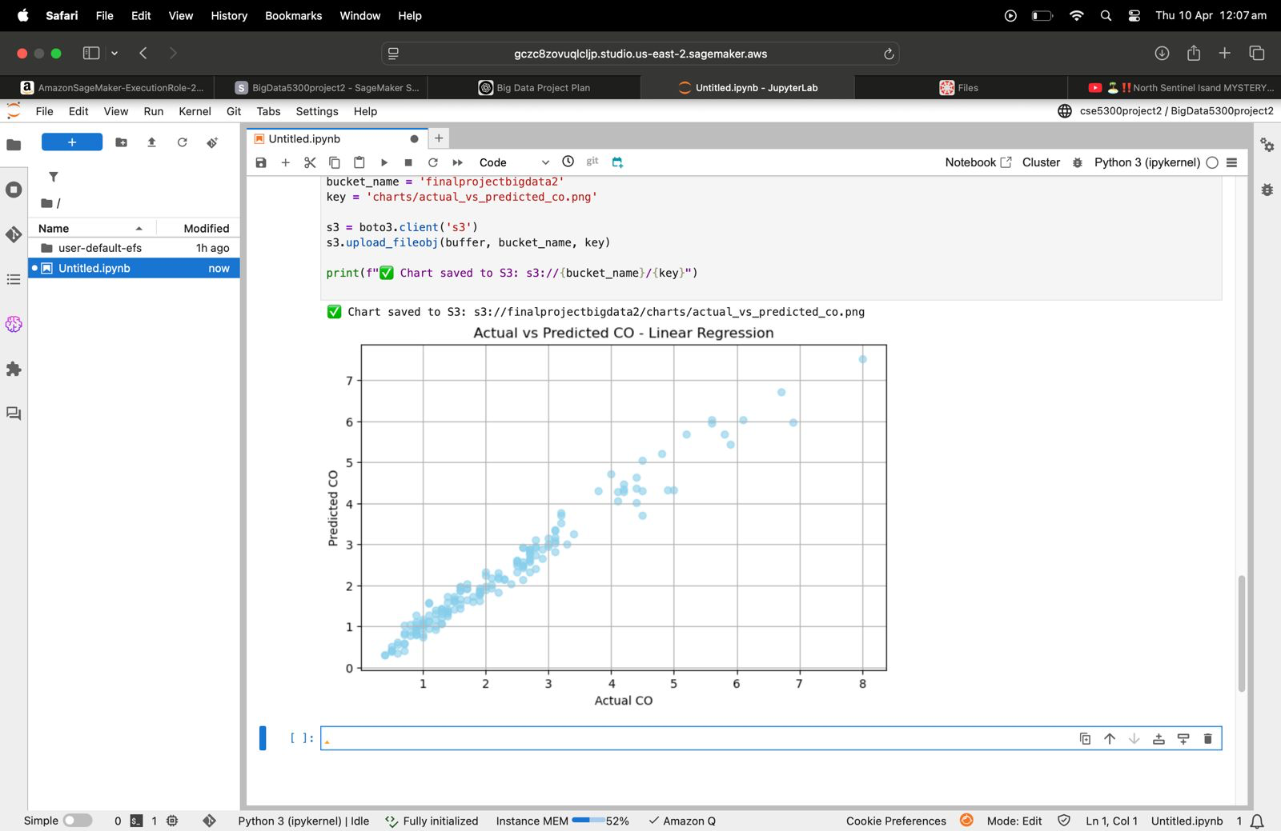
Actual vs Predicted Plot (S3 Upload Confirmation):
The same scatter plot is saved and uploaded to Amazon S3 through Boto3.
The code makes sure that the chart is saved at: s3://finalprojectbigdata2 This illustrates end-to-end integration from cloud to model to visualization storage.

Slide 19
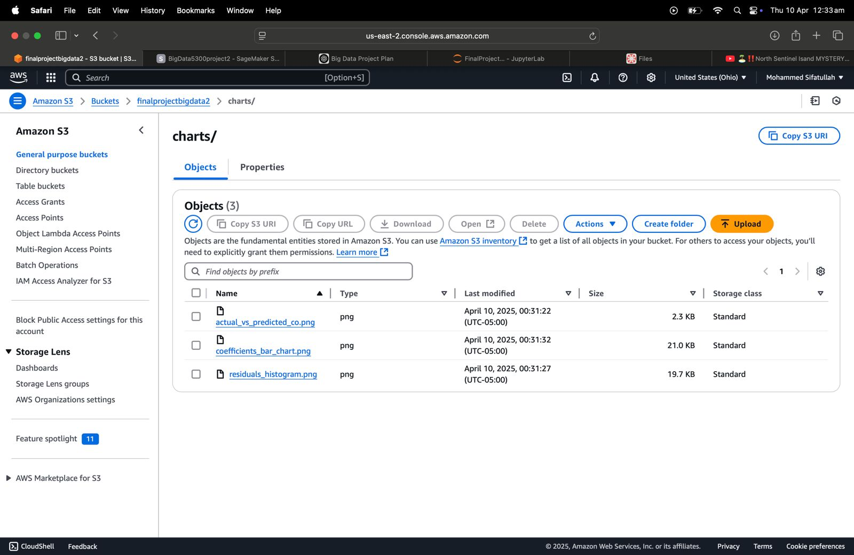
S3 Bucket for Final Output Storage:
After training and testing the machine learning model within SageMaker Studio, visualizations (graphs and charts) were stored for futurereference.
These include Actual vs Predicted CO plot, Histogram of Residuals, and Linear Regression Coefficients bar chart.
All of the charts created were stored automatically to a dedicated directory (charts/) of the S3 bucket finalprojectbigdata2, withcentralized and organized storage of results.

Slide 20
Conclusion
This two-pronged project illustrated the seamless integration of Big Data technologies and AWS cloud services. In Phase 1, we utilized Hive on AWS to process and prepare raw air quality data, thus ensuring a structured and analysis-ready format.
In Phase 2, the prepared dataset was kept intact within S3 at Amazon and used in AWS SageMaker Studio to build and evaluate a Linear Regression model to predict carbon monoxide (CO) levels based on several air quality measures.
Model performance was evaluated through usage of critical visualizations, which included Actual vs. Predicted CO, Residual Distribution, and Feature Coefficient Analysis. The visualrepresentations were later stored in S3 to facilitate scalable and cloud-based access and reporting.

Slide 21
Project Management
Phase 1 involved creation of a large data pipeline based on Amazon Web Services, with specific focus on S3, EMR, and Hive. Raw data was first kept in store in Amazon S3, later cleaned through Hive SQL on EMR, where processes like imputation for missing values, correction of anomalies, and transformation into an orderly format fit for machine learning usage occurred.
The team ensured proper implementation of all steps of preprocessing through checking of data output and successful retransfer of cleanseddata to S3. The systematic and iterative retransfer provided a strong basis for machine learning integration.
For Phase 2, SageMaker Studio was used for building and training a Linear Regression model. The task division was clearly defined: preprocessing, model building, visualization, and documentation were methodically covered. All members of the team worked together, takingcare that project deliverables were met within the timeframe specified, with outputs stored for long-term retrieval in S3.

Slide 22
Responsibility &Contributions
Name | Tasks | Contribution
R.Saikumarreddy | Aws setup, Data Preprocessing ,Documentation | 30%
Krishna Chaitanya Kandepu | Data Storage, Hive queries, Documentation | 20%
Karanam Dimpu Nithish | Tools setup, Hive quries,Documentation | 30%
Mohammed Sifatullah | Documentation | 20%

Slide 23
Challenges & Refrences:
Issues/Concerns: 1.Optimization is one of the big challenges for writing the queries and processing the data. We solved this challenge by distributing ,partitioning the workflow, queries to get the accurate results 2.The next Challenge is Logistical concerns were coordinating with the setup of emr,hive among the team members but we resolved this with the proper documentation, task delegations.
References/Bibliography:
UCI Air Quality Dataset - https://archive.ics.uci.edu/ml/datasets/air+quality
Apache Hive Documentation - https://cwiki.apache.org/confluence/display/Hive/Home
Amazon Web Services (AWS) Documentation - https://aws.amazon.com/documentation/
S3 bucket storted in AWS path : s3://finalprojectbigdata2/air_quality_filtered_labeled.csv

Slide 24
Thank you !

